Slide 1
Three Parts of the Scoreboard
Instruction status
  Which of 4 steps the instruction is in
Register result status
  Indicates which functional unit will write each register, if one exists
  Blank when no pending instructions will write that register
Functional unit status
  Indicates the state of the FU
  9 fields for each functional unit
College of Computer, NUDT
Notes:
What you might have thought
1. 4 stages of instruction executino
2.Status of FU: Normal things to keep track of (RAW & structura for busyl):
Fi from instruction format of the mahine (Fi is dest)
Add unit can Add or Sub
Rj, Rk - status of registers (Yes means ready)
Qj,Qk - If a no in Rj, Rk, means waiting for a FU to write result; Qj, Qk means wihch FU waiting for it
3.Status of register result (WAW &WAR)s:
which FU is going to write into registers
Scoreboard on 6600 = size of FU
6.7, 6.8, 6.9, 6.12, 6.13, 6.16, 6.17
FU latencies: Add 2, Mult 10, Div 40 clocks

Slide 2
9 Fields for Each Functional Unit
Busy: Indicates the unit is busy or not
Op: Operation to perform in the unit (e.g., + or –)
Fi: Destination register
Fj, Fk: Source-register numbers
Qj, Qk: Functional units producing source registers Fj, Fk
Rj, Rk: Flags indicating when Fj, Fk are ready
College of Computer, NUDT
Notes:
What you might have thought
1. 4 stages of instruction executino
2.Status of FU: Normal things to keep track of (RAW & structura for busyl):
Fi from instruction format of the mahine (Fi is dest)
Add unit can Add or Sub
Rj, Rk - status of registers (Yes means ready)
Qj,Qk - If a no in Rj, Rk, means waiting for a FU to write result; Qj, Qk means wihch FU waiting for it
3.Status of register result (WAW &WAR)s:
which FU is going to write into registers
Scoreboard on 6600 = size of FU
6.7, 6.8, 6.9, 6.12, 6.13, 6.16, 6.17
FU latencies: Add 2, Mult 10, Div 40 clocks

Slide 3
How It Works
L.D F6, 34(R2)
L.D F2, 45(R3)
MUL.D F0, F2, F4
SUB.D F8, F2, F6
DIV.D F10, F0, F6
ADD.D F6, F8, F2
College of Computer, NUDT

Slide 4
RAWs
L.D F6, 34(R2)
L.D F2, 45(R3)
MUL.D F0, F2, F4
SUB.D F8, F2, F6
DIV.D F10, F0, F6
ADD.D F6, F8, F2
College of Computer, NUDT

Slide 5
WARs
L.D F6, 34(R2)
L.D F2, 45(R3)
MUL.D F0, F2, F4
SUB.D F8, F2, F6
DIV.D F10, F0, F6
ADD.D F6, F8, F2
College of Computer, NUDT

Slide 6
EX Cycle Latencies
EX cycle latencies for the FP function units
  ADD is 2 clock cycles
  MULTIPLY is 10 cycles
  DIVIDE is 40 cycles
College of Computer, NUDT

Slide 7
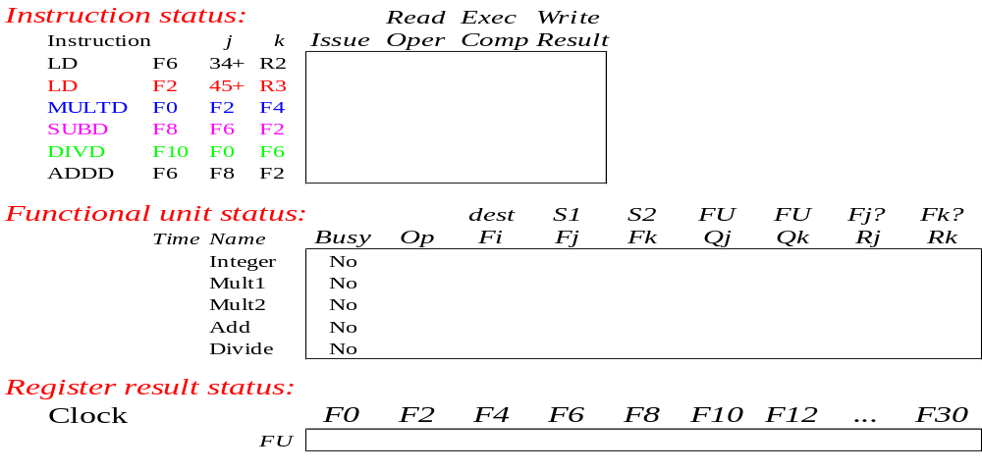
Scoreboard Example
College of Computer, NUDT

Slide 8
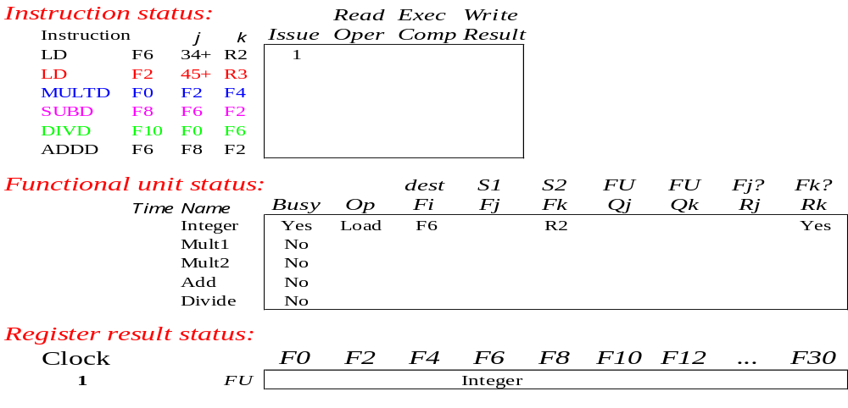
Scoreboard Example: Cycle 1
College of Computer, NUDT

Slide 9
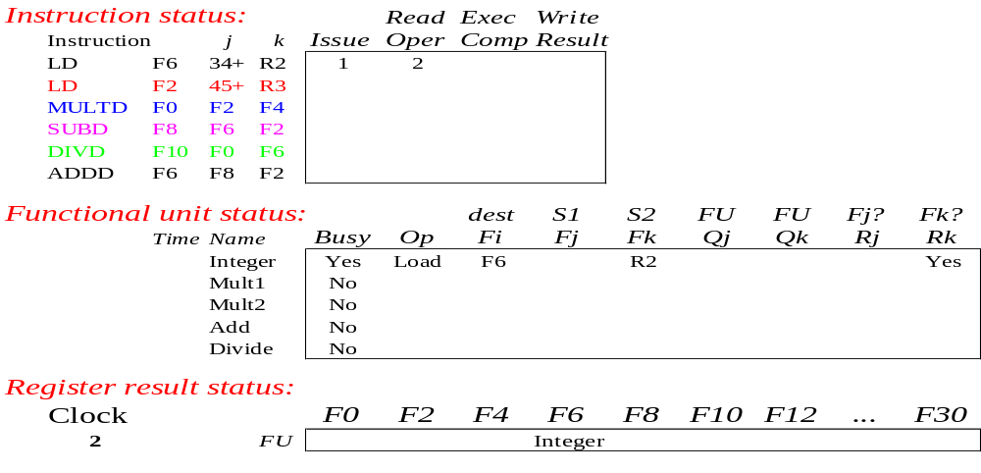
Scoreboard Example: Cycle 2
College of Computer, NUDT

Slide 10
Scoreboard Example: Cycle 2
Issue 2nd LD?
College of Computer, NUDT

Slide 11
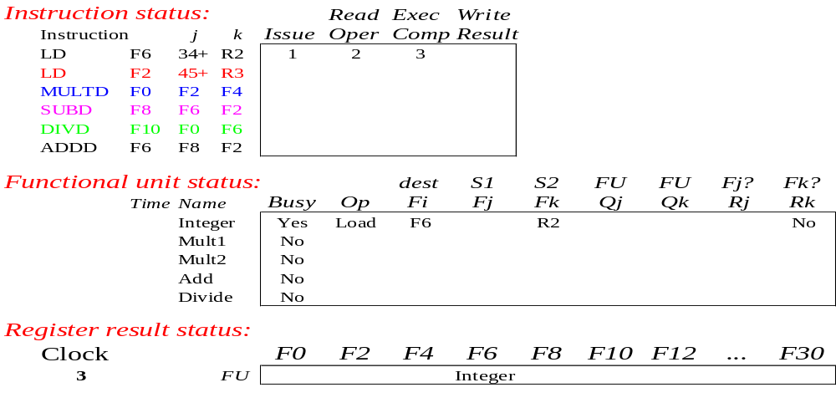
Scoreboard Example: Cycle 3
College of Computer, NUDT

Slide 12
Scoreboard Example: Cycle 3
Issue MULT?
College of Computer, NUDT

Slide 13
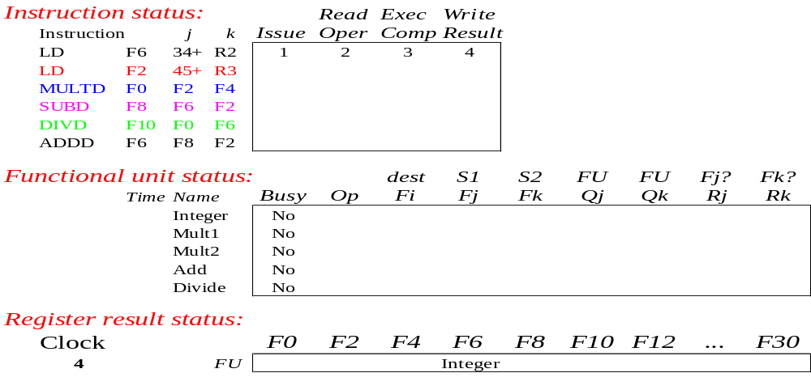
Scoreboard Example: Cycle 4
College of Computer, NUDT

Slide 14
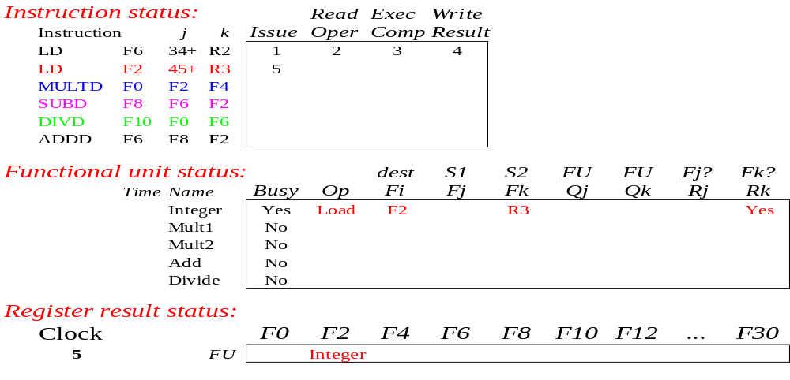
Scoreboard Example: Cycle 5
College of Computer, NUDT

Slide 15
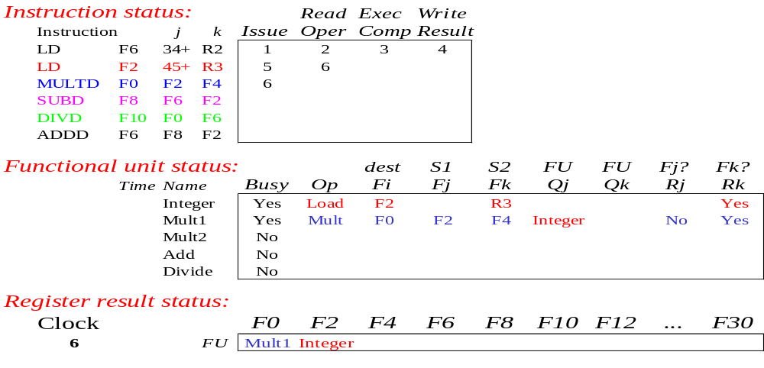
Scoreboard Example: Cycle 6
College of Computer, NUDT

Slide 16
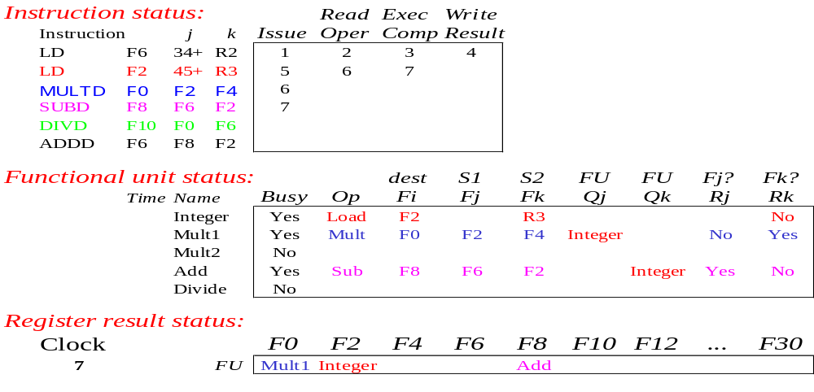
Scoreboard Example: Cycle 7
College of Computer, NUDT

Slide 17
Scoreboard Example: Cycle 7
Read multiply operands?
College of Computer, NUDT

Slide 18
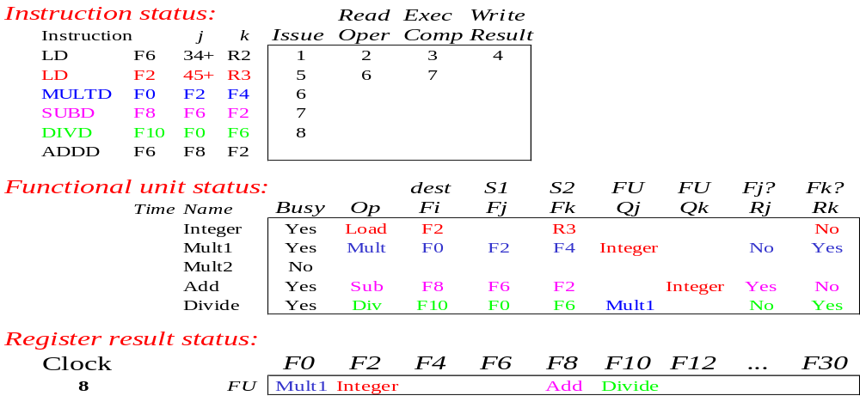
Scoreboard Example: Cycle 8a (First half of clock)
Read operands for MULT & SUB?
College of Computer, NUDT

Slide 19
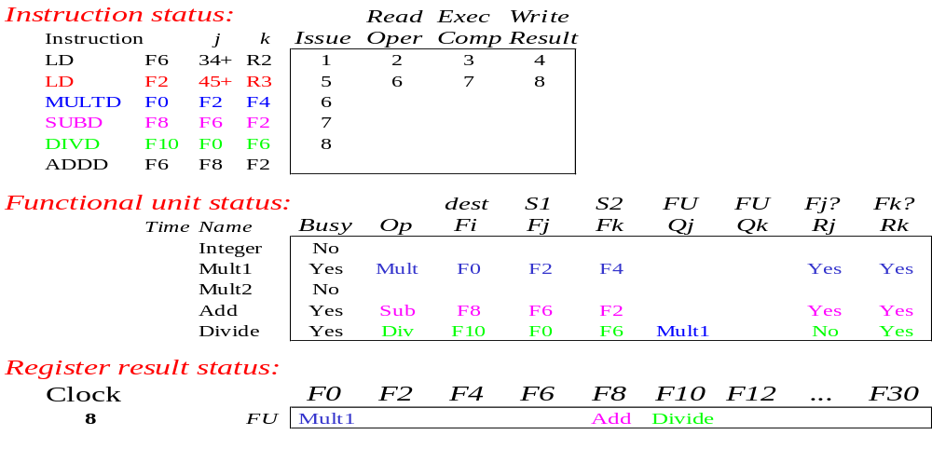
Scoreboard Example: Cycle 8b (Second half of clock)
College of Computer, NUDT

Slide 20
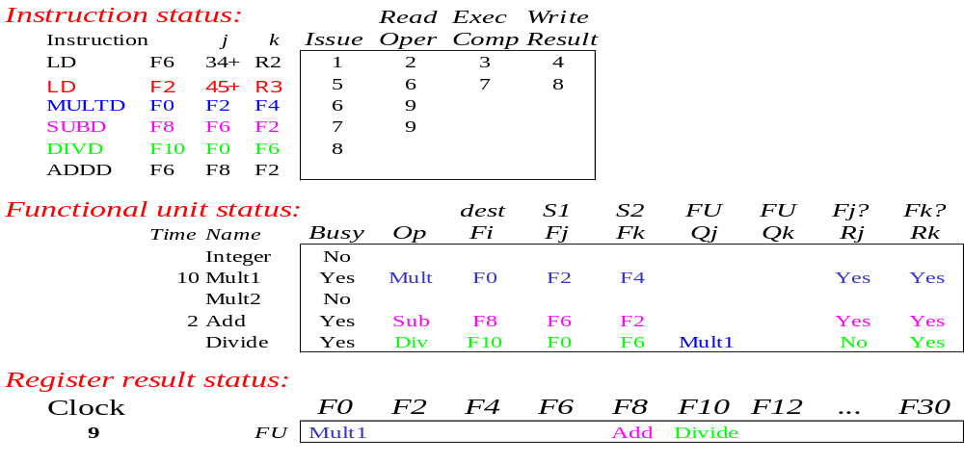
Scoreboard Example: Cycle 9
Note
Remaining
College of Computer, NUDT

Slide 21
Scoreboard Example: Cycle 9
Issue ADDD?
Note
Remaining
College of Computer, NUDT

Slide 22

Scoreboard Example: Cycle 10
College of Computer, NUDT

Slide 23

Scoreboard Example: Cycle 11
College of Computer, NUDT

Slide 24
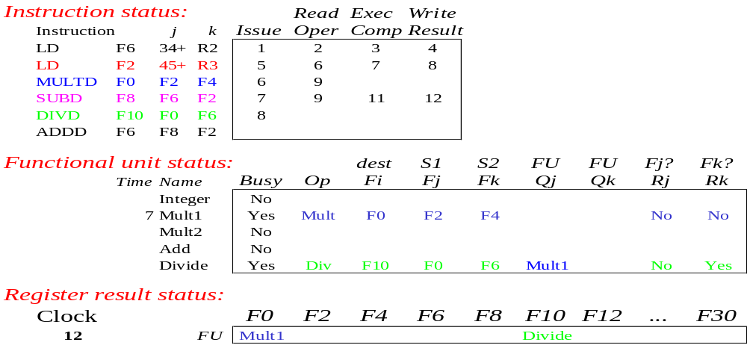
Scoreboard Example: Cycle 12
College of Computer, NUDT

Slide 25
Scoreboard Example: Cycle 12
Read operands for DIVD?
Issue ADDD?
College of Computer, NUDT

Slide 26
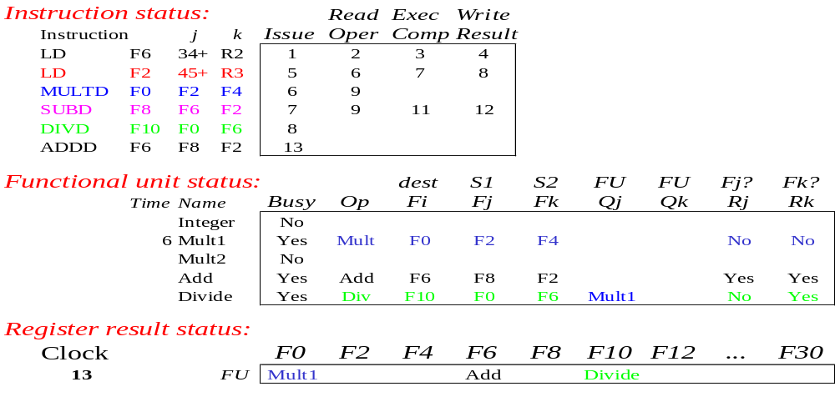
Scoreboard Example: Cycle 13
College of Computer, NUDT

Slide 27
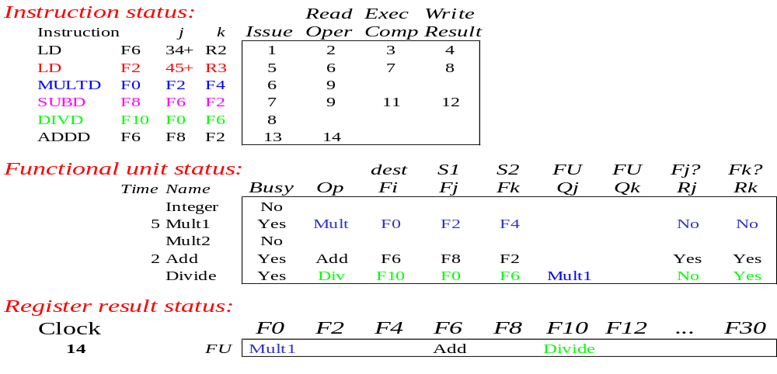
Scoreboard Example: Cycle 14
College of Computer, NUDT

Slide 28

Scoreboard Example: Cycle 15
College of Computer, NUDT

Slide 29
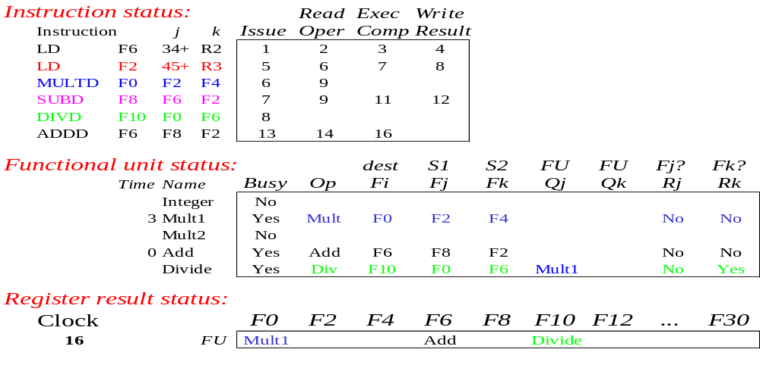
Scoreboard Example: Cycle 16
College of Computer, NUDT

Slide 30

Scoreboard Example: Cycle 17
College of Computer, NUDT

Slide 31
Scoreboard Example: Cycle 17
Why not write result of ADDD?
College of Computer, NUDT

Slide 32
Scoreboard Example: Cycle 17
Why not write result of ADDD?
WAR Hazard!
College of Computer, NUDT

Slide 33

Scoreboard Example: Cycle 18
College of Computer, NUDT

Slide 34

Scoreboard Example: Cycle 19
College of Computer, NUDT

Slide 35
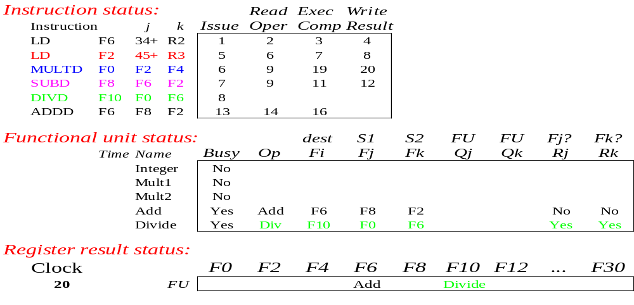
Scoreboard Example: Cycle 20
College of Computer, NUDT

Slide 36

Scoreboard Example: Cycle 21
College of Computer, NUDT

Slide 37

Scoreboard Example: Cycle 21
WAR Hazard is now gone...
College of Computer, NUDT

Slide 38
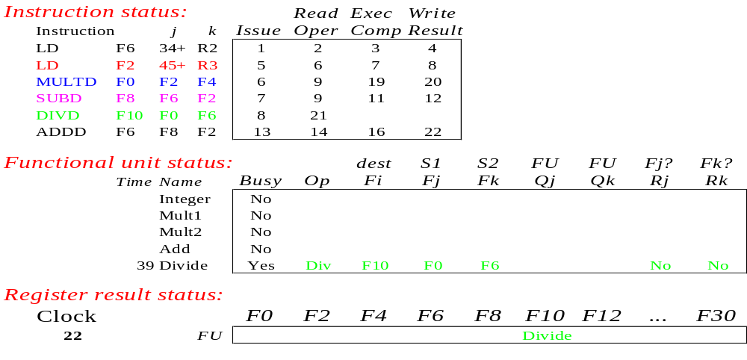
Scoreboard Example: Cycle 22
College of Computer, NUDT

Slide 39
Faster than light computation
(skip a couple of cycles)
College of Computer, NUDT

Slide 40
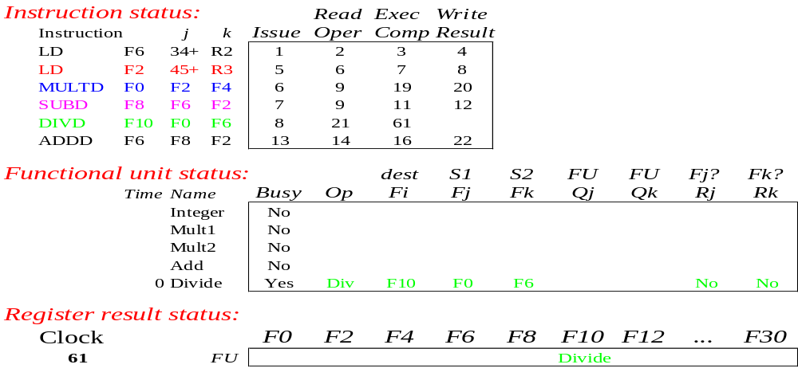
Scoreboard Example: Cycle 61
College of Computer, NUDT

Slide 41
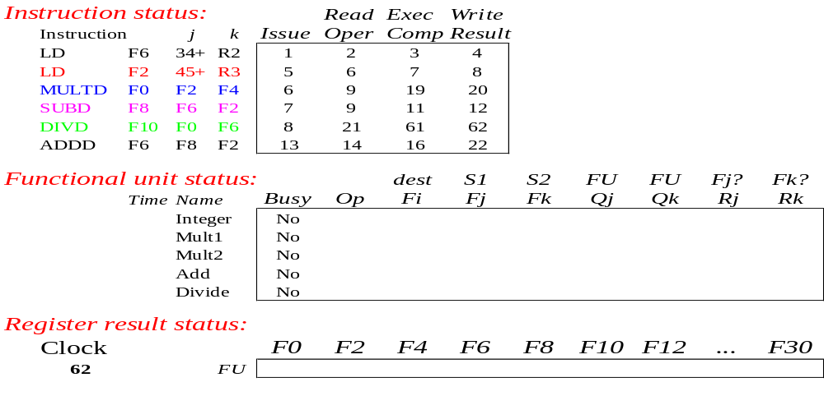
Scoreboard Example: Cycle 62
College of Computer, NUDT

Slide 42
Review: Scoreboard Status
College of Computer, NUDT

Slide 43
Review: Scoreboard Status
In-order issue
Out-of-order execute
Out-of-order WR
College of Computer, NUDT

Slide 44
Issue
not Busy[FU] and not Result [D]
Bookkeeping
  Busy[FU] ← yes; OP[FU] ← Op;
  Fi[FU] ← D; Fj[FU] ← S1; Fk[FU] ← S2;
  Qj ← Result[S1]; Qk ← Result[S2];
  Rj ← not Qj; Rk ← not Qk;
  Result[D] ← FU;
College of Computer, NUDT

Slide 45
Read operands
Rj and Rk
    //operands are ready, check RAW
Bookkeeping
  Rj ← No; Rk ← No;
    //Rj, Rk have been used
  Qj ← 0; Qk ← 0;
    //no FU results are waited
College of Computer, NUDT

Slide 46
Execution
Execution complete
  Functional unit done
College of Computer, NUDT

Slide 47
Write Result
Wait until ∀f((Fj[f] ≠ Fi[FU] or Rj[f] = no) & (Fk[f] ≠ Fi[FU] or Rk[f] = no));
Bookkeeping
  ∀f(if Qj[f] = FU then Rj[f] ← yes);
    //all Fjs are OK
  ∀f(if Qk[f] = FU then Rk[f] ← yes);
    //all Fks are OK
  Result [Fi[FU]] ← 0;
  Busy[FU] ← No;
College of Computer, NUDT

Slide 48
The Example Again
Show what the status tables look like when following insts. are each ready to go to the just before WR state
  (1) MUL.D
  (2) DIV.D
College of Computer, NUDT

Slide 49
MUL.D Ready WR: Instruction Status 1
Instruction | IS | RO | EX | WR
L.D F6,34(R2)
L.D F2,45(R3)
MUL.D F0,F2,F4 | √ | √ | √
SUB.D F8,F6,F2
DIV.D F10,F0,F6
ADD.D F6,F8,F2
College of Computer, NUDT

Slide 50
MUL.D Ready WR: Instruction Status 2
Instruction | IS | RO | EX | WR
L.D F6,34(R2) | √ | √ | √ | √
L.D F2,45(R3) | √ | √ | √ | √
MUL.D F0,F2,F4 | √ | √ | √
SUB.D F8,F6,F2
DIV.D F10,F0,F6
ADD.D F6,F8,F2
College of Computer, NUDT

Slide 51
MUL.D Ready WR: Instruction Status 3
Instruction | IS | RO | EX | WR
L.D F6,34(R2) | √ | √ | √ | √
L.D F2,45(R3) | √ | √ | √ | √
MUL.D F0,F2,F4 | √ | √ | √
SUB.D F8,F6,F2 | √ | √ | √ | √
DIV.D F10,F0,F6
ADD.D F6,F8,F2
College of Computer, NUDT

Slide 52
MUL.D Ready WR: Instruction Status 4
Instruction | IS | RO | EX | WR
L.D F6,34(R2) | √ | √ | √ | √
L.D F2,45(R3) | √ | √ | √ | √
MUL.D F0,F2,F4 | √ | √ | √
SUB.D F8,F6,F2 | √ | √ | √ | √
DIV.D F10,F0,F6 | √
ADD.D F6,F8,F2
College of Computer, NUDT

Slide 53
MUL.D Ready WR: Instruction Status 5
Instruction | IS | RO | EX | WR
L.D F6,34(R2) | √ | √ | √ | √
L.D F2,45(R3) | √ | √ | √ | √
MUL.D F0,F2,F4 | √ | √ | √
SUB.D F8,F6,F2 | √ | √ | √ | √
DIV.D F10,F0,F6 | √
ADD.D F6,F8,F2 | √ | √ | √
College of Computer, NUDT

Slide 54
MUL.D Ready WR: Function Unit Status
Name | Busy | Op | Fi | Fj | Fk | Qj | Qk | Rj | Rk
Int | No
Mult1 | Yes | Mult | F0 | F2 | F4 |  |  | No | No
Mult2 | No
Add | Yes | Add | F6 | F8 | F2 |  |  | No | No
Divide | Yes | Div | F10 | F0 | F6 | Mult1 |  | No | Yes
College of Computer, NUDT

Slide 55
MUL.D Ready WR: Register Result Status
 | F0 | F2 | F4 | F6 | F8 | F10 | … | F30
FU | Mult1 |  |  | Add |  | Divide
College of Computer, NUDT

Slide 56
DIV.D Is Reay to WR
Instruction | IS | RO | EX | WR
L.D F6,34(R2) | √ | √ | √ | √
L.D F2,45(R3) | √ | √ | √ | √
MUL.D F0,F2,F4 | √ | √ | √ | √
SUB.D F8,F6,F2 | √ | √ | √ | √
DIV.D F10,F0,F6 | √ | √ | √
ADD.D F6,F8,F2 | √ | √ | √ | √
College of Computer, NUDT

Slide 57
Before DIV.D : Function Unit Status
Name | Busy | Op | Fi | Fj | Fk | Qj | Qk | Rj | Rk
Int | No
Mult1 | No
Mult2 | No
Add | No
Divide | Yes | Div | F10 | F0 | F6 |  |  | No | No
College of Computer, NUDT

Slide 58
Before DIV.D : Register Result Status
 | F0 | F2 | F4 | F6 | F8 | F10 | … | F30
FU |  |  |  |  |  | Divide
College of Computer, NUDT

Slide 59
Scoreboarding in Our MIPS
The scoreboard dynamically
  Resolves RAW hazards
    minimize the stalls from RAW
  Out-of-order execution
  Out-of-order completion
Two Problems of Scoreboard
  Does not take the the advantage of forwarding
  Write result and read operand cannot overlap
College of Computer, NUDT

Slide 60
Scoreboard on the CDC 6600
CDC 6600
  No software pipeline scheduling
  No semiconductor main memory
  No caches (lower memory-access time)
Cost of scoreboard on the CDC 6600 is surprisingly low
  About as much logic as one of the FU
  The main cost is large number of buses (data trunk) that is about four times as many as executing in order
College of Computer, NUDT

Slide 61
The CDC6600 Benefits
The designers measured
Improvement | Cede Type
1.7 | FORTRAN
2.5 | hand-coded assembly
College of Computer, NUDT

Slide 62
Limitations of 6600 Scoreboard
No forwarding hardware
Limited to instructions in basic block
  Small window
Small number of functional units
  Structural hazards
  Especially integer/load store units
Do not issue on structural hazards
Wait for WAR hazards
Prevent WAW hazards
College of Computer, NUDT

Slide 63
Summary
Hazards limit performance
  Structural: need more HW resources
  Data: need forwarding, compiler scheduling
  Control: early evaluation & PC, delayed branch, prediction
ILP found either by compiler or hardware
Increasing length of pipe increases impact of hazards
  Pipelining helps instruction bandwidth, not latency!
College of Computer, NUDT

Slide 64
Ambitiously
Missing from 6600 Scoreboard?
  Hardware renaming – name dependencies limiting our potential speedup on loops!
    Can we rename in hardware?
    Of course – next time
  Concurrent write result to destination register and read operands
College of Computer, NUDT

Slide 65
Homework
Summary
  Textbook C.7
Review
  Parallel Operation in the Control Data 6600
  Design and Implementation of RISC I (an assignment of Lecture 03)
College of Computer, NUDT

